Slide 1
Ikea clone
,

Slide 2
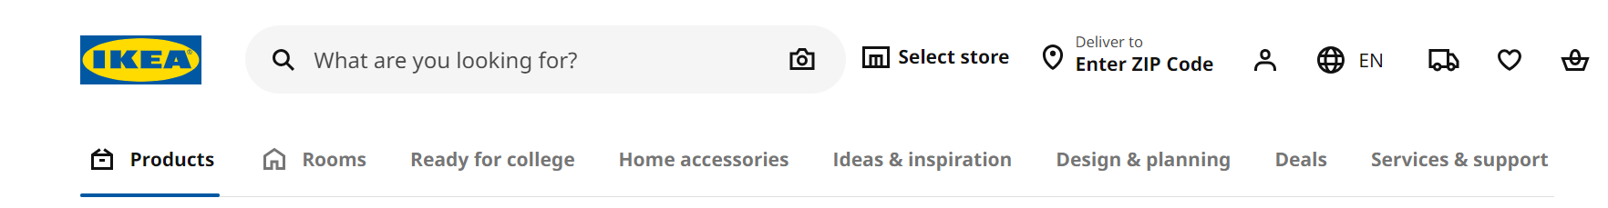
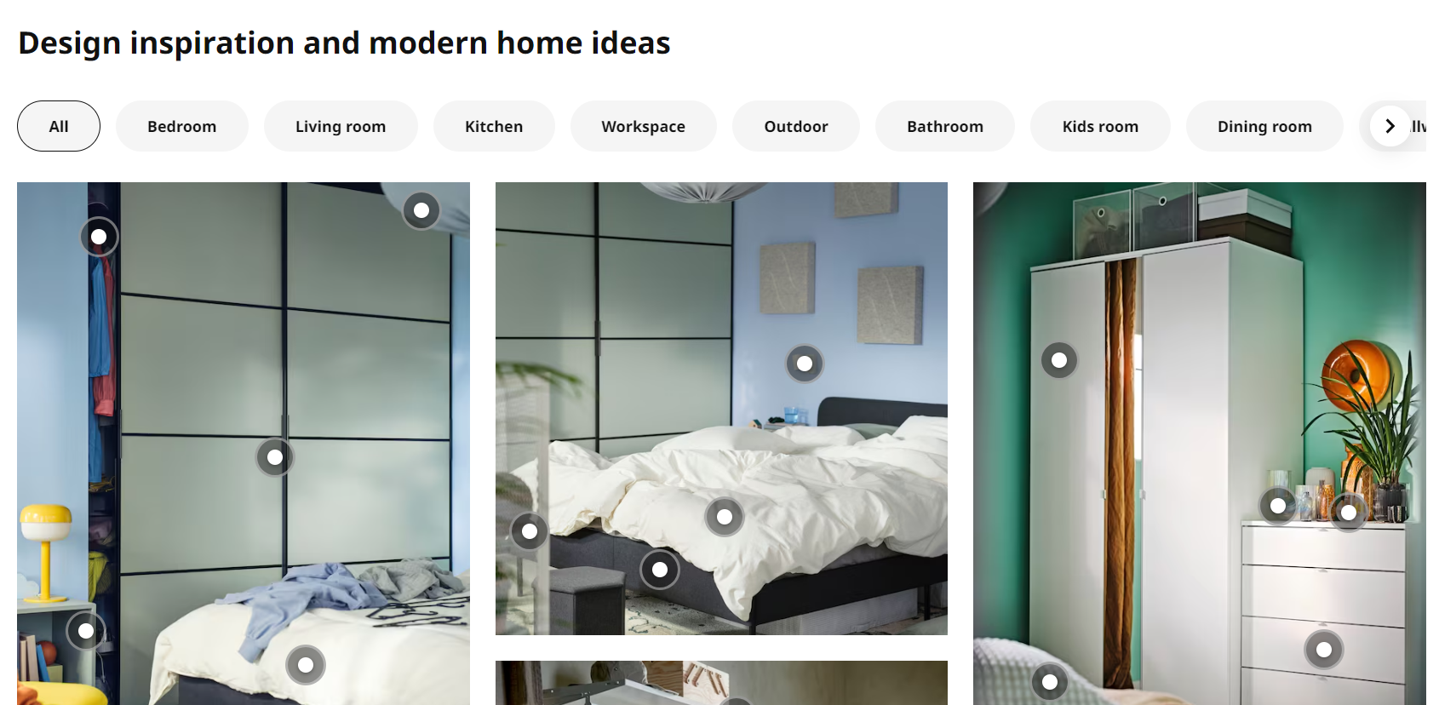
.
Only selected items from the nav bar above.

Slide 3
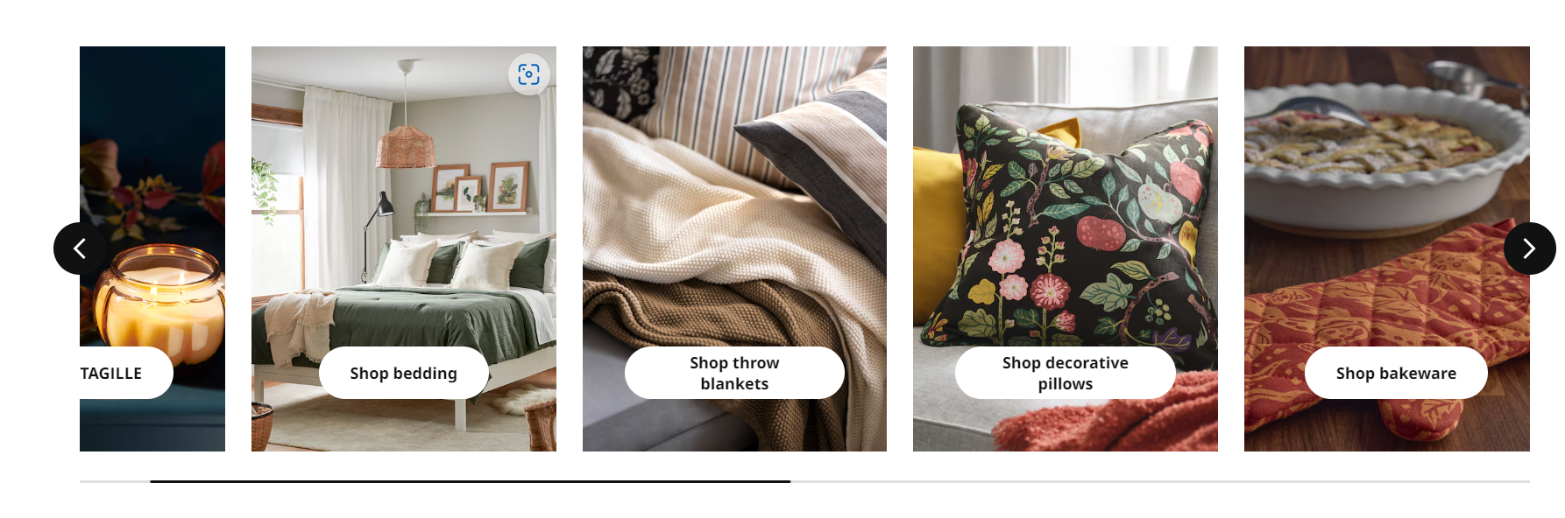
Page1

Slide 4
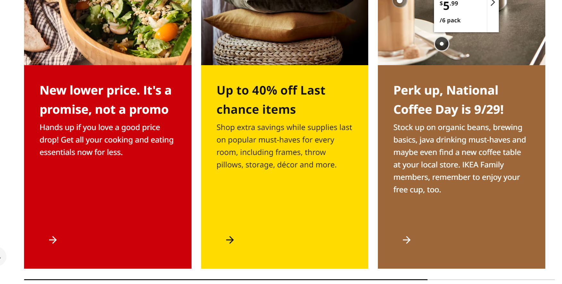

Slide 5
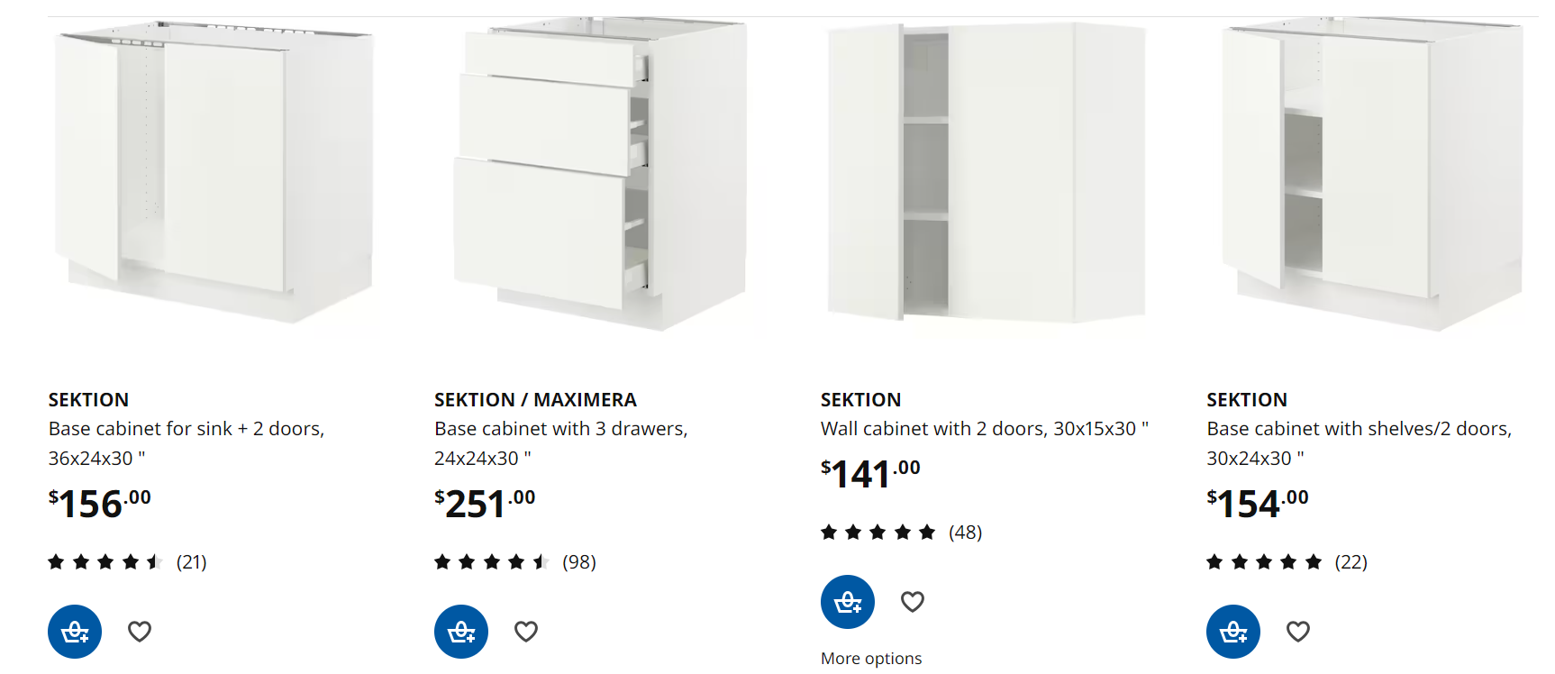
Page2
This will be products page

Slide 6
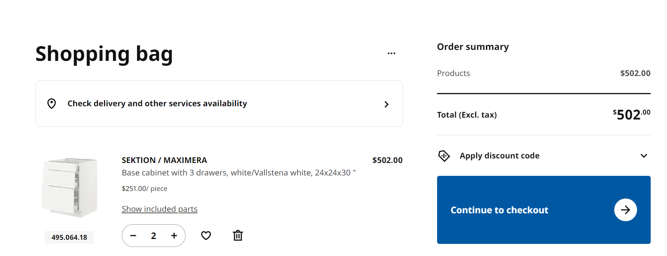
Cart Page

Slide 7
All these components will come in handy for other pages as well.
.

